Slide 1

Synergistically utilize technically sound portals with frictionless chainsSynergistically
PowerPoint templates
Synergistically utilize technically sound portals with, Synergistically utilize technically sound, , Synergistically

Slide 2
Contents
Synergistically utilize technically sound portals with, Synergistically utilize technically sound
Synergistically utilize technically sound portals with, Synergistically utilize technically sound
Synergistically utilize technically sound portals with, Synergistically utilize technically sound
Synergistically utilize technically sound portals with, Synergistically utilize technically sound

Slide 3
Synergistically utilize technically sound portals with frictionless chainsSynergistically
Part one
Synergistically utilize technically sound portals with, Synergistically utilize technically sound, , Synergistically

Slide 4
Synergistically utilize technically sound portals with, Synergistically utilize technically sound, , Synergistically

Slide 5
Mon
Tue
Wed
Thu
Fri
Sat
Synergistically utilize technically sound portals with, Synergistically utilize technically 。Synergistically utilize technically sound portals with, Synergistically utilize technically sound,
Synergistically utilize technically sound portals with, Synergistically utilize technically 。Synergistically utilize technically sound portals with, Synergistically utilize technically sound,
Synergistically utilize technically sound portals with, Synergistically utilize technically 。Synergistically utilize technically sound portals with, Synergistically utilize technically sound,
Synergistically utilize technically sound portals with, Synergistically utilize technically 。Synergistically utilize technically sound portals with, Synergistically utilize technically sound,
Synergistically utilize technically sound portals with, Synergistically utilize technically 。Synergistically utilize technically sound portals with, Synergistically utilize technically sound,
Synergistically utilize technically sound portals with, Synergistically utilize technically 。Synergistically utilize technically sound portals with, Synergistically utilize technically sound,

Slide 6
Synergistically utilize technically sound portals with frictionless chainsSynergistically
Part two
Synergistically utilize technically sound portals with, Synergistically utilize technically sound, , Synergistically

Slide 7

Synergistically utilize technically sound portals with, Synergistically utilize technically
Synergistically utilize technically sound portals with, Synergistically utilize technically
Synergistically utilize technically sound portals with, Synergistically utilize technically
450 - 1450
1450 - 1600
1600 - 1750
1750 - 1820
1820 - 1900
1900 - NOW
Synergistically utilize technically sound portals with, Synergistically utilize technically
Synergistically utilize technically sound portals with, Synergistically utilize technically
Synergistically utilize technically sound portals with, Synergistically utilize technically

Slide 8
Title text
Title text
Title text
Synergistically utilize technically sound portals with, Synergistically utilize technically 。Synergistically utilize technically sound portals with, Synergistically utilize technically sound,
Synergistically utilize technically sound portals with, Synergistically utilize technically 。Synergistically utilize technically sound portals with, Synergistically utilize technically sound,
Synergistically utilize technically sound portals with, Synergistically utilize technically 。Synergistically utilize technically sound portals with, Synergistically utilize technically sound,

Slide 9


Title text
Title text
Synergistically utilize technically sound portals with, Synergistically utilize technically。Synergistically utilize technically. Synergistically utilize technically sound portals with, Synergistically utilize technically。Synergistically utilize technically
Synergistically utilize technically sound portals with, Synergistically utilize technically。Synergistically utilize technically
Title text
Title text
Title text
Title text
Synergistically utilize technically sound portals with, Synergistically utilize technically 。Synergistically utilize technically sound portals with, Synergistically utilize technically sound,
Synergistically utilize technically sound portals with, Synergistically utilize technically 。Synergistically utilize technically sound portals with, Synergistically utilize technically sound,

Slide 10
Title text
Synergistically utilize technically sound portals with, Synergistically utilize technically。Synergistically utilize technically sound portals
Synergistically utilize technically sound portals with, Synergistically utilize technically。Synergistically utilize technically sound portals
Synergistically utilize technically sound portals with, Synergistically utilize technically。Synergistically utilize technically sound portals

Slide 11
Synergistically utilize technically sound portals with frictionless chainsSynergistically
Part three
Synergistically utilize technically sound portals with, Synergistically utilize technically sound, , Synergistically

Slide 12

60%
Synergistically utilize technically sound portals with, Synergistically utilize technically 。Synergistically utilize technically sound portals with, Synergistically utilize technically sound,
30%
Synergistically utilize technically sound portals with, Synergistically utilize technically 。Synergistically utilize technically sound portals with, Synergistically utilize technically sound,
20%
Synergistically utilize technically sound portals with, Synergistically utilize technically 。Synergistically utilize technically sound portals with, Synergistically utilize technically sound,

Slide 13
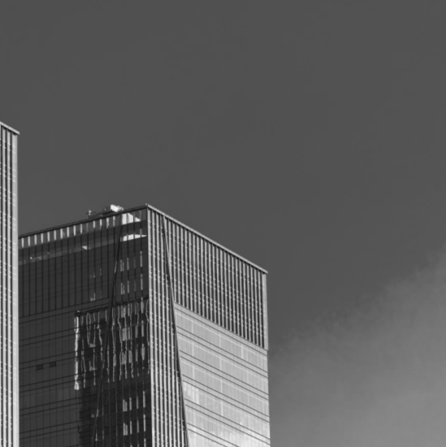
Title text
Synergistically utilize technically sound portals with, Synergistically utilize technically 。Synergistically utilize technically sound portals with, Synergistically
Title text
Synergistically utilize technically sound portals with, Synergistically utilize technically 。Synergistically utilize technically sound portals with, Synergistically
Title text
Synergistically utilize technically sound portals with, Synergistically utilize technically 。Synergistically utilize technically sound portals with, Synergistically
Title text

Slide 14
Title text
Title text
Title text
Title text
Title text
50%
60%
70%
80%
Synergistically utilize technically sound portals with, Synergistically utilize technically。Synergistically utilize technically
Synergistically utilize technically sound portals with, Synergistically utilize technically。Synergistically utilize technically
Synergistically utilize technically sound portals with, Synergistically utilize technically。Synergistically utilize technically
Synergistically utilize technically sound portals with, Synergistically utilize technically。Synergistically utilize technically

Slide 15
Day
01
Synergistically utilize technically sound portals with, Synergistically utilize technically。Synergistically utilize technically
Synergistically utilize technically sound portals with, Synergistically utilize technically。Synergistically utilize technically
Synergistically utilize technically sound portals with, Synergistically utilize technically。Synergistically utilize technically
Synergistically utilize technically sound portals with, Synergistically utilize technically。Synergistically utilize technically

Slide 16

Title text
A
C
Synergistically utilize technically sound portals with, Synergistically utilize technically sound。Synergistically utilize technically sound
Synergistically utilize technically sound portals with, Synergistically utilize technically sound。Synergistically utilize technically sound
Synergistically utilize technically sound portals with, Synergistically utilize technically sound。Synergistically utilize technically sound
Synergistically utilize technically sound portals with, Synergistically utilize technically sound。Synergistically utilize technically sound
B
D

Slide 17
Synergistically utilize technically sound portals with frictionless chainsSynergistically
Part four
Synergistically utilize technically sound portals with, Synergistically utilize technically sound, , Synergistically

Slide 18
Title text
Synergistically utilize technically sound portals with, Synergistically utilize technically。Synergistically utilize technically
Synergistically utilize technically sound portals with, Synergistically utilize technically。Synergistically utilize technically
Synergistically utilize technically sound portals with, Synergistically utilize technically。Synergistically utilize technically
Synergistically utilize technically sound portals with, Synergistically utilize technically。Synergistically utilize technically

Slide 19
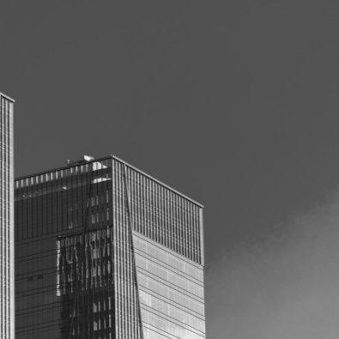
Title text
Synergistically utilize technically sound portals with, Synergistically utilize technically 。Synergistically utilize technically sound portals with, Synergistically utilize technically sound, ,
Synergistically utilize technically sound portals with, Synergistically utilize technically 。Synergistically utilize technically sound portals with, Synergistically utilize technically sound, ,
Synergistically utilize technically sound portals with, Synergistically utilize technically 。Synergistically utilize technically sound portals with, Synergistically utilize technically sound, ,
Synergistically utilize technically sound portals with, Synergistically utilize technically 。Synergistically utilize technically sound portals with, Synergistically utilize technically sound, ,

Slide 20

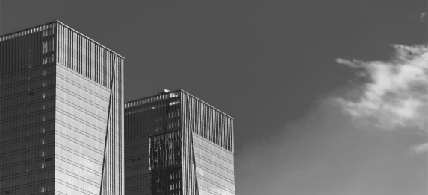

Title text
Title text
Title text
Synergistically utilize technically sound portals with, Synergistically utilize technically
Synergistically utilize technically sound portals with, Synergistically utilize technically
Synergistically utilize technically sound portals with, Synergistically utilize technically

Slide 21
Title text
Synergistically utilize technically sound portals with, Synergistically utilize technically。Synergistically utilize technically
01
02
Synergistically utilize technically sound portals with, Synergistically utilize technically。Synergistically utilize technically
Synergistically utilize technically sound portals with, Synergistically utilize technically。Synergistically utilize technically
03
04
Synergistically utilize technically sound portals with, Synergistically utilize technically。Synergistically utilize technically

Slide 22
Title text
Title text
Synergistically utilize technically sound portals with, Synergistically utilize technically 。Synergistically utilize technically sound portals with,
Title text
Synergistically utilize technically sound portals with, Synergistically utilize technically 。Synergistically utilize technically sound portals with,
Synergistically utilize technically sound portals with, Synergistically utilize technically
Title text
Synergistically utilize technically sound portals with, Synergistically utilize technically 。Synergistically utilize technically sound portals with,

Slide 23

Title text
Synergistically utilize technically sound portals with, Synergistically utilize technically 。Synergistically utilize technically sound portals with, Synergistically utilize technically sound,
Synergistically utilize technically sound portals with, Synergistically utilize technically 。Synergistically utilize technically sound portals with, Synergistically utilize technically sound,
Synergistically utilize technically sound portals with, Synergistically utilize technically 。Synergistically utilize technically sound portals with, Synergistically utilize technically sound,

Slide 24
Title text
Synergistically utilize technically sound portals with, Synergistically utilize technically 。Synergistically utilize technically sound portals with, Synergistically utilize technically sound,
Synergistically utilize technically sound portals with, Synergistically utilize technically 。Synergistically utilize technically sound portals with, Synergistically utilize technically sound,
Synergistically utilize technically sound portals with, Synergistically utilize technically 。Synergistically utilize technically sound portals with, Synergistically utilize technically sound,

Slide 25
Synergistically utilize technically sound portals with frictionless chainsSynergistically
THANK YOU
Synergistically utilize technically sound portals with, Synergistically utilize technically sound, , Synergistically

